Slide 1
Cost of Living Analysis
Kandra Aashritha

Slide 2
Abstract
This project focuses on analyzing the cost of living in various cities and countries worldwide. The dataset includes a wide range of economic indicators, covering prices of basic commodities, housing, transportation, and entertainment costs. By leveraging the capabilities of power BI, we aim to uncover valuable insights into the economic disparities between different regions and identify the factors driving the variations in living costs. This project emphasizes data visualization, analysis, and interpretation, providing a thorough overview of the global economic landscape.

Slide 3
PROBLEM STATEMENT
The cost of living is a crucial metric that impacts individuals and businesses alike. Understanding the cost of living in different cities and countries is vital for making informed decisions regarding relocation, investment, or business expansion. This project aims to address several key questions:
• What are the cities and countries with the highest and lowest costs of living?
• What are the major cost components contributing to the overall cost of living in a region?
• How do factors like average salary, housing costs, and transportation expenses correlate with the cost of living?
• Are there any trends or patterns in the data that can help individuals and organizations make strategic decisions?

Slide 4
STEPS INVOLVED
Data import
Data cleaning and preprocessing
Data transformation
Exploratory data analysis
Comparative analysis

Slide 5
Dataset Details
The dataset consists of the following variables:
• City: Name of the city.
• Country: Name of the country.
• Column Description
• city Name of the city
• country Name of the country
• x1 Meal, Inexpensive Restaurant (USD)
• x2 Meal for 2 People, Mid-range Restaurant, Three-course (USD)
• x3 McMeal at McDonalds (or Equivalent Combo Meal) (USD)
• x4 Domestic Beer (0.5 liter draught, in restaurants) (USD)
• x5 Imported Beer (0.33 liter bottle, in restaurants) (USD)
• x6 Cappuccino (regular, in restaurants) (USD)
• x7 Coke/Pepsi (0.33 liter bottle, in restaurants) (USD)
• x8 Water (0.33 liter bottle, in restaurants) (USD)
• x9 Milk (regular), (1 liter) (USD)
• x10 Loaf of Fresh White Bread (500g) (USD)

Slide 6
• x11 Rice (white), (1kg) (USD)
• x12 Eggs (regular) (12) (USD)
• x13 Local Cheese (1kg) (USD)
• x14 Chicken Fillets (1kg) (USD)
• x15 Beef Round (1kg) (or Equivalent Back Leg Red Meat) (USD)
• x16 Apples (1kg) (USD)
• x17 Banana (1kg) (USD)
• x18 Oranges (1kg) (USD)
• x19 Tomato (1kg) (USD)
• x20 Potato (1kg) (USD)
• x21 Onion (1kg) (USD)
• x22 Lettuce (1 head) (USD)
• x23 Water (1.5 liter bottle, at the market) (USD)
• x24 Bottle of Wine (Mid-Range, at the market) (USD)
• x25 Domestic Beer (0.5 liter bottle, at the market) (USD)
• x26 Imported Beer (0.33 liter bottle, at the market) (USD)
• x27 Cigarettes 20 Pack (Marlboro) (USD)
• x28 One-way Ticket (Local Transport) (USD)
• x29 Monthly Pass (Regular Price) (USD)
• x30 Taxi Start (Normal Tariff) (USD)

Slide 7
• x31 Taxi 1km (Normal Tariff) (USD)
• x32 Taxi 1hour Waiting (Normal Tariff) (USD)
• x33 Gasoline (1 liter) (USD)
• x34 Volkswagen Golf 1.4 90 KW Trendline (Or Equivalent New Car) (USD)
• x35 Toyota Corolla Sedan 1.6l 97kW Comfort (Or Equivalent New Car) (USD)
• x36 Basic (Electricity, Heating, Cooling, Water, Garbage) for 85m2 Apartment (USD)
• x37 1 min. of Prepaid Mobile Tariff Local (No Discounts or Plans) (USD)
• x38 Internet (60 Mbps or More, Unlimited Data, Cable/ADSL) (USD)
• x39 Fitness Club, Monthly Fee for 1 Adult (USD)
• x40 Tennis Court Rent (1 Hour on Weekend) (USD)
• x41 Cinema, International Release, 1 Seat (USD)
• x42 Preschool (or Kindergarten), Full Day, Private, Monthly for 1 Child (USD)
• x43 International Primary School, Yearly for 1 Child (USD)
• x44 1 Pair of Jeans (Levis 501 Or Similar) (USD)
• x45 1 Summer Dress in a Chain Store (Zara, H&M, ...) (USD)
and 1 indicating satisfactory data quality.

Slide 8
• x46 1 Pair of Nike Running Shoes (Mid-Range) (USD)
• x47 1 Pair of Men Leather Business Shoes (USD)
• x48 Apartment (1 bedroom) in City Centre (USD)
• x49 Apartment (1 bedroom) Outside of Centre (USD)
• x50 Apartment (3 bedrooms) in City Centre (USD)
• x51 Apartment (3 bedrooms) Outside of Centre (USD)
• x52 Price per Square Meter to Buy Apartment in City Centre (USD)
• x53 Price per Square Meter to Buy Apartment Outside of Centre (USD)
• x54 Average Monthly Net Salary (After Tax) (USD)
• x55 Mortgage Interest Rate in Percentages (%), Yearly, for 20 Years Fixed-Rate
• data_quality 0 if Numbeo considers that more contributors are needed to increase data
quality, else 1data_quality: A binary variable (0 or 1) indicating data quality, with 0 suggesting
the need for more contributors

Slide 9
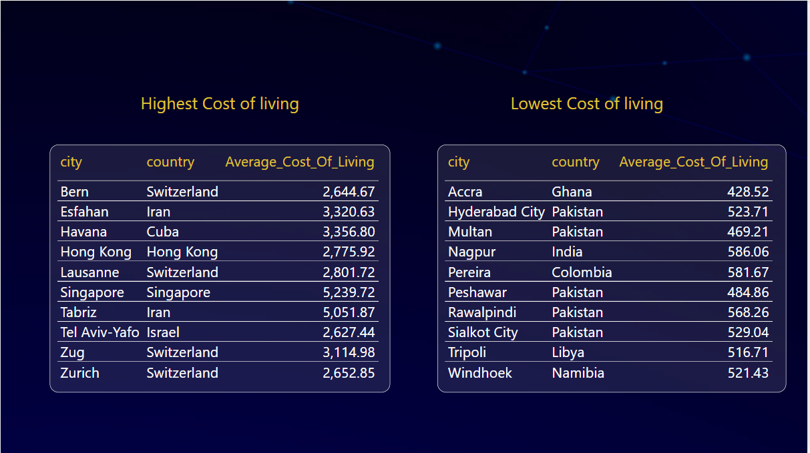
1. What are the cities and countries with the highest and lowest costs of living?

Slide 10
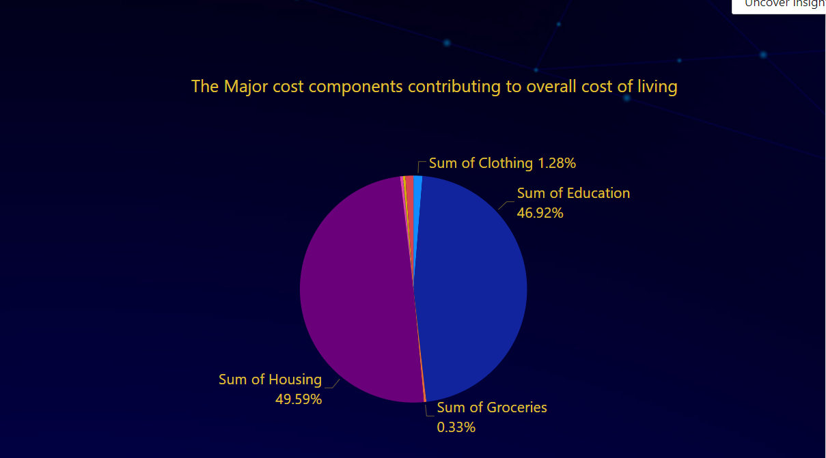
2.What are the major cost components contributing to the overall cost of living in a region?

Slide 11
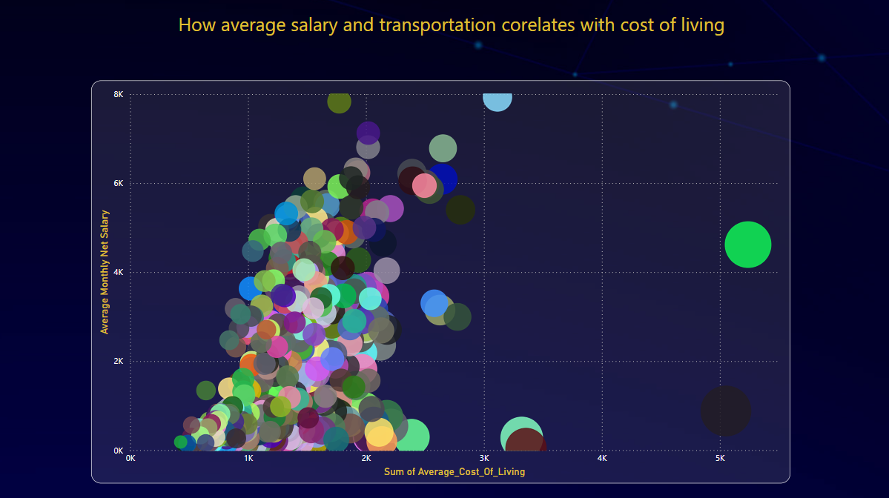
3 – How do factors like average salary, housing costs, and transportation expenses correlate with the cost of living?

Slide 12
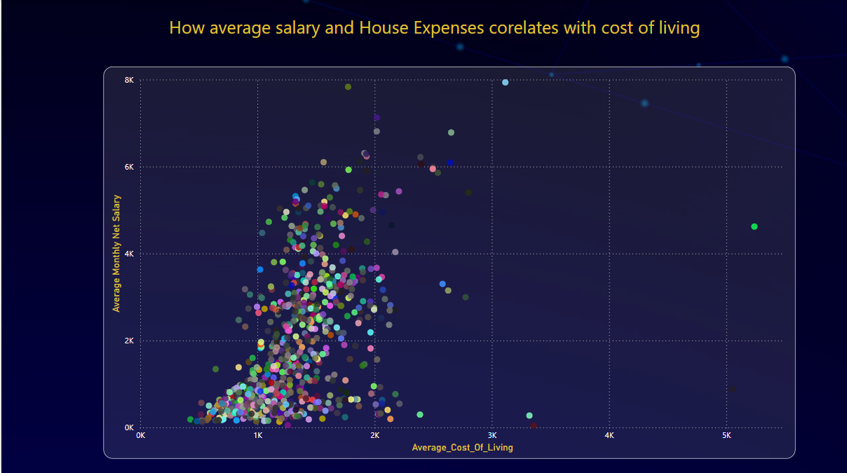

Slide 13
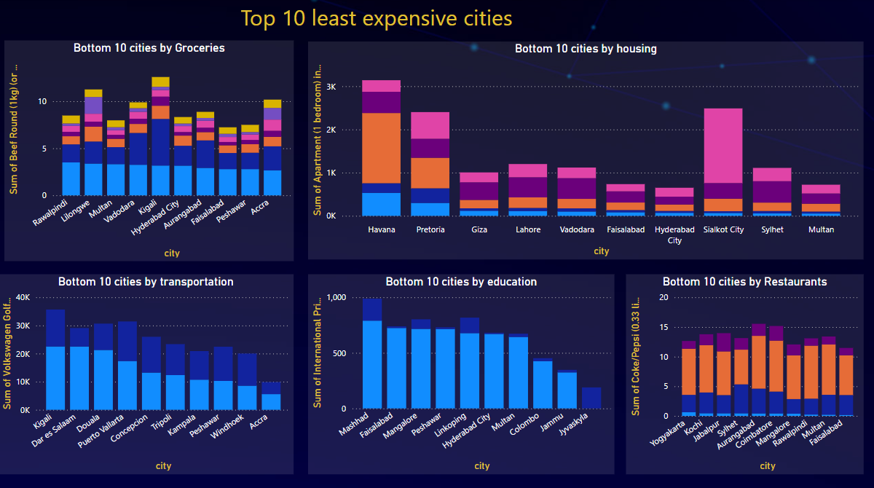
4 - Are there any trends or patterns in the data that can help individuals and organizations make strategic decisions?

Slide 14
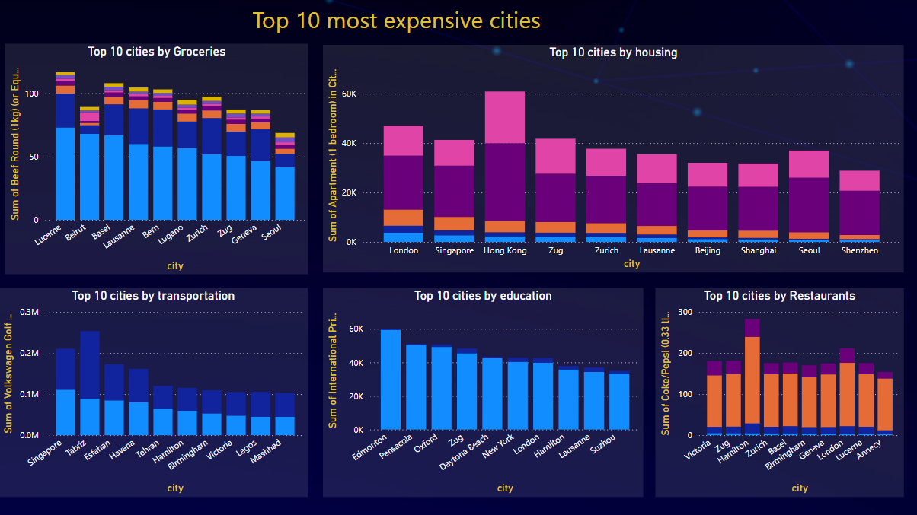

Slide 15
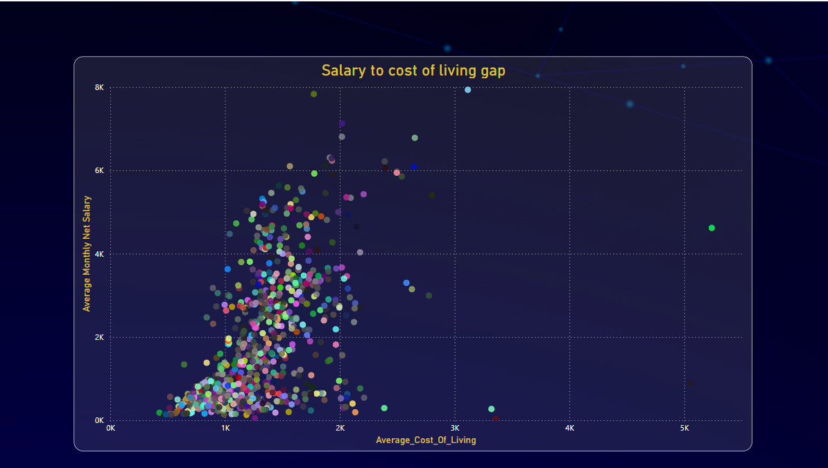

Slide 16
Thank you

